Slide 1
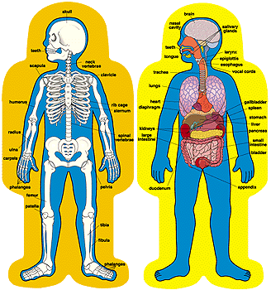

Slide 2
Mental ‘ill-health’
Myths and definitions

Slide 3
What is ‘health?’
Discuss this with your partner…

Slide 4
What is ‘health’?
World Health Organization:
‘Health is a state of complete physical, mental and social well-being and not merely the absence of disease’.

Slide 5

Wellness continuum
- Where would you place yourself?
- How would you label each section?

Slide 6
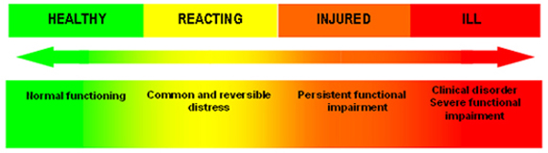
Would any of you move yourselves?

Slide 7
What impacts upon your movement along this scale?

Slide 8
What is mental health?
Discuss in your groups…

Slide 9
What is ‘mental health?’
World Health Organization
‘Mental health is defined as a state of well-being in which every individual realizes his or her own potential, can cope with the normal stresses of life, can work productively and fruitfully, and is able to make a contribution to her or his community’.

Slide 10
What things can you do to move in this direction ◄◄◄◄

